Slide 1
An Analysis of Long-Term Worldwide Economic Growth Data
Sam Virsik

Slide 2
Goals for the Project
What are the most significant factors which influence the growth of a country?
What are the best economic indicators of that growth?
EX: Trade, labor force, political stability, technological innovation
*Able to be determined through data analysis
EX: GDP per capita, country health, capital formation
*Not able to be well determined through data analysis

Slide 3

Determining Economic Growth Indicators
*Not easy to be done through my data analysis
Actual growth is much more complex than any list of a few variables
Emerging from Poverty by Gerald Meier
His advice was to look more towards improvements of country health, not just increases in Gross National Product (GNP)

Slide 4
Variables Used
Influential Factors
Imports
Exports
Net Exports (Exports-Imports)
Net migration
Labor force, total
Population
Urban population
Rural population
Economic Indicators
Economy Based
GDP Per Capita
GDP per capita (constant LCU)
GDP growth (annual %)
GDP (current LCU)
GDP (constant 2015 US$)
Gross capital formation (% of GDP)
Consumer price index (2010 = 100)
Labor force, total
Population
Country Health
Life expectancy at birth, total (years)
Birth rate, crude (per 1,000 people)
Population ages 0-14 (% of total population)
Death rate, crude (per 1,000 people)
Other
CO2 emissions (kt)

Slide 5
Variables Used
Influential Factors
Imports
Exports
Net Exports (Exports-Imports)
Net migration
Labor force, total
Population
Urban population
Rural population
Economic Indicators
Economy Based
GDP Per Capita
GDP per capita (constant LCU)
GDP growth (annual %)
GDP (current LCU)
GDP (constant 2015 US$)
Gross capital formation (% of GDP)
Consumer price index (2010 = 100)
Labor force, total
Population
Country Health
Life expectancy at birth, total (years)
Birth rate, crude (per 1,000 people)
Population ages 0-14 (% of total population)
Death rate, crude (per 1,000 people)
Other
CO2 emissions (kt)
*Note: Many of these can be both influencers and indicators (analysis is not causal)

Slide 6
Sourcing the Data
Trade Data: United Nations Department of Economic and Social Affairs
https://unstats.un.org/unsd/trade/data/tables.asp
GDP per Capita, Population Data: University of Groningen Maddison Project
https://www.rug.nl/ggdc/historicaldevelopment/maddison/releases/maddison-project-database-2020
Economy and Health Data: The World Bank World Development Indicators Dataset
https://databank.worldbank.org/reports.aspx?source=2&series=NY.GDP.PCAP.CD&country=#

Slide 7
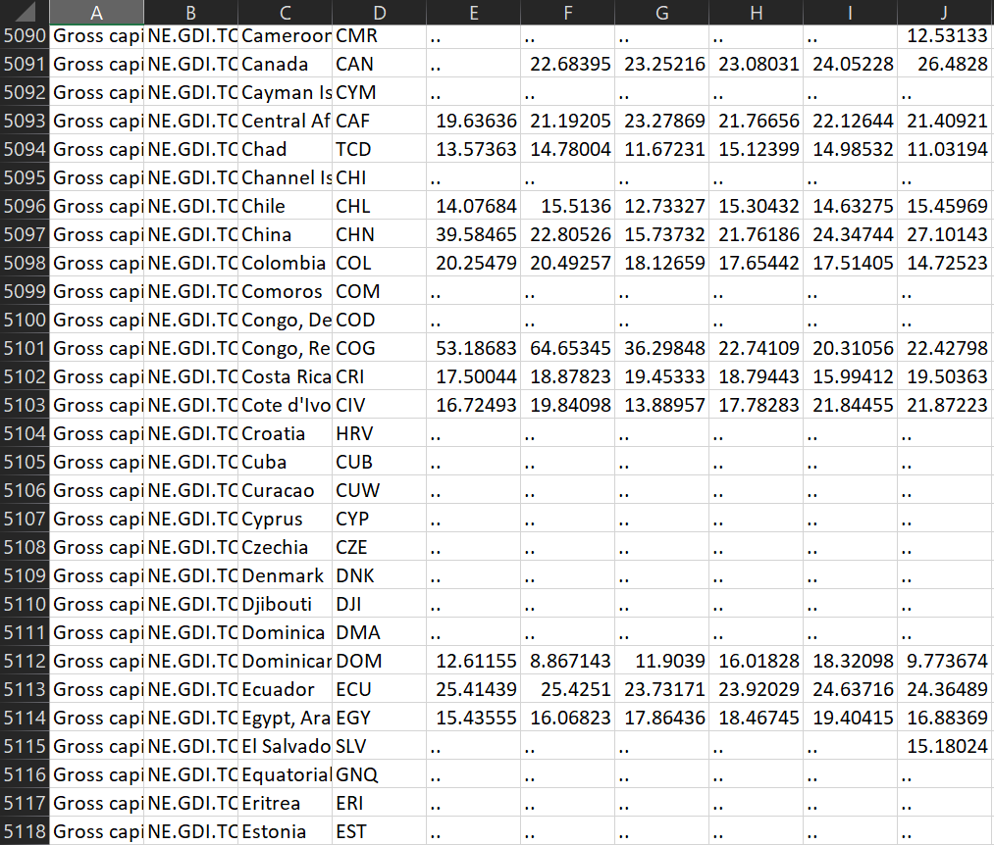
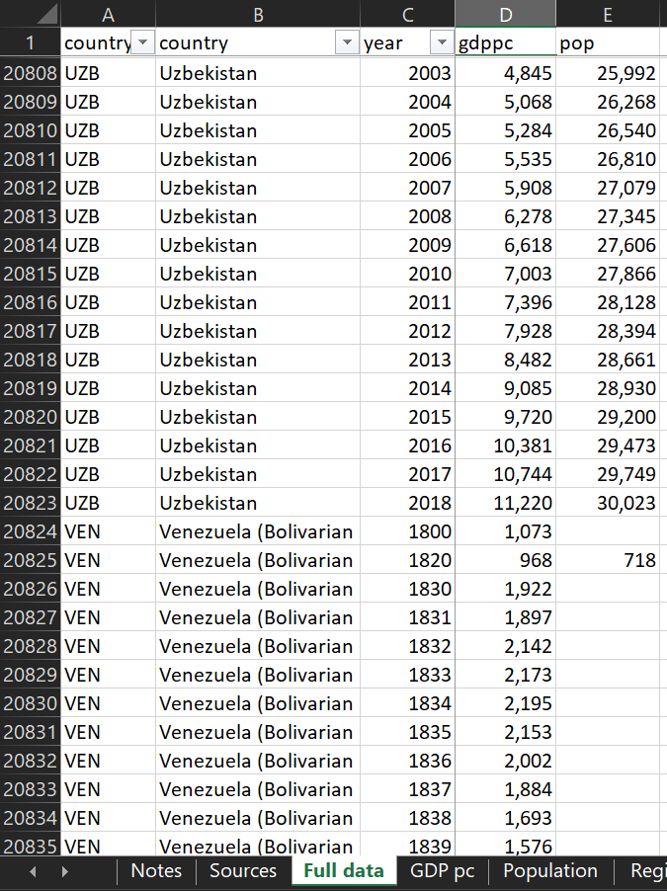
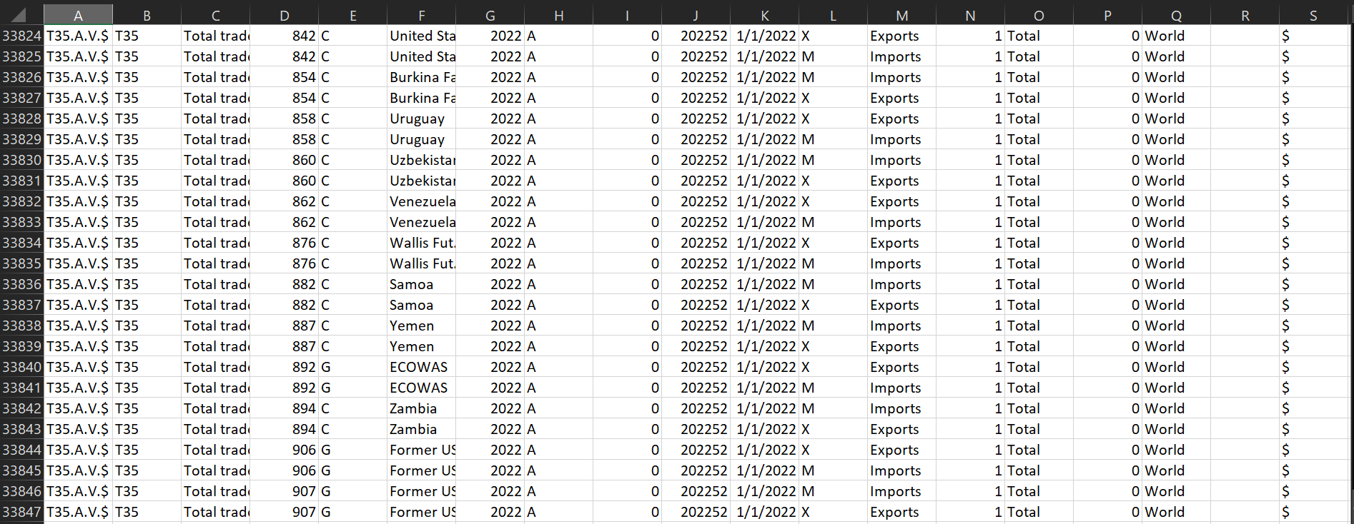
Data Prep and Processing
Done in python
Different dataset formatting and convention
Very large scale
Quite difficult

Slide 8
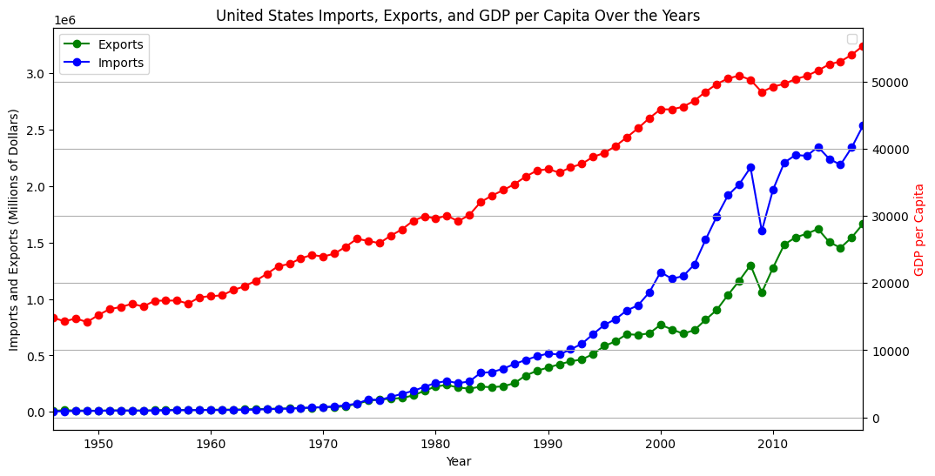
United States Imports, Exports, GDPPC

Slide 9
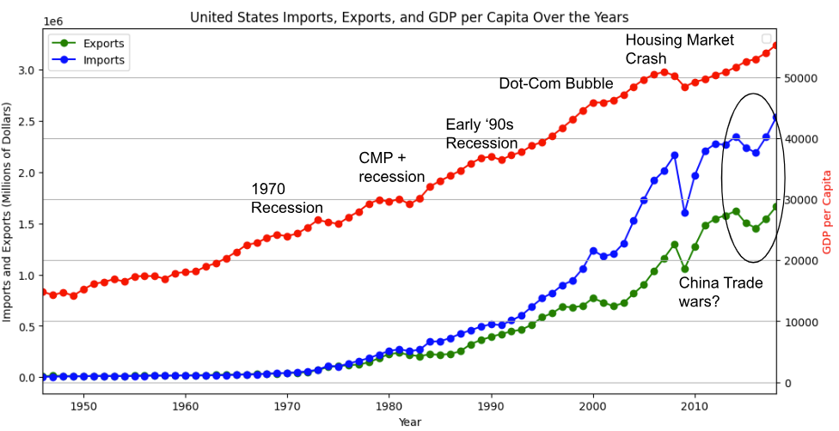
United States Imports, Exports, GDPPC

Slide 10
Method for Large Scale Analysis
Choose indicator (EX: GDP Per Capita)
Loop through every influential factor (imports, exports, etc)
Loop through every country
Determined the R² correlation between the two variables
R²: The proportion of variance in the dependent variable which is predicted by the independent variable
Make results into boxplot
14 indicators * 8 predictors * ≈180 countries * ≈70 years of data

Slide 11
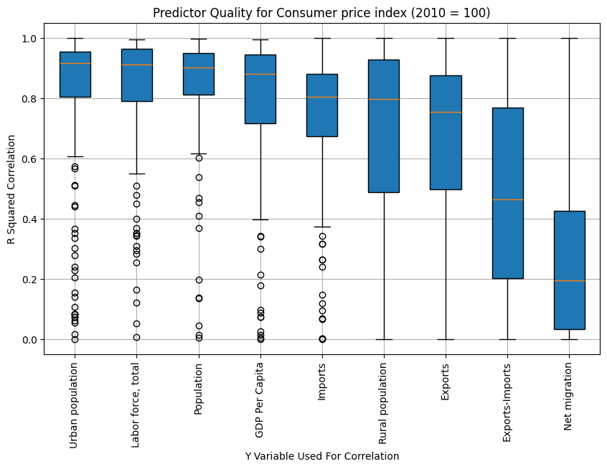
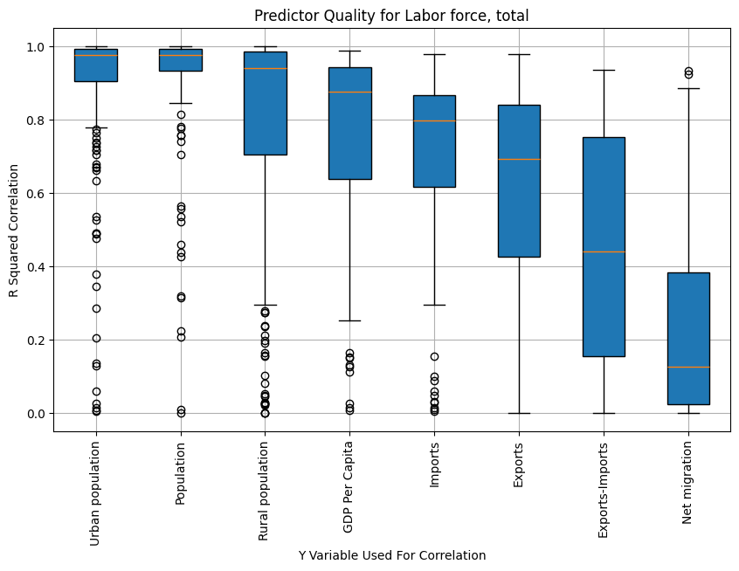
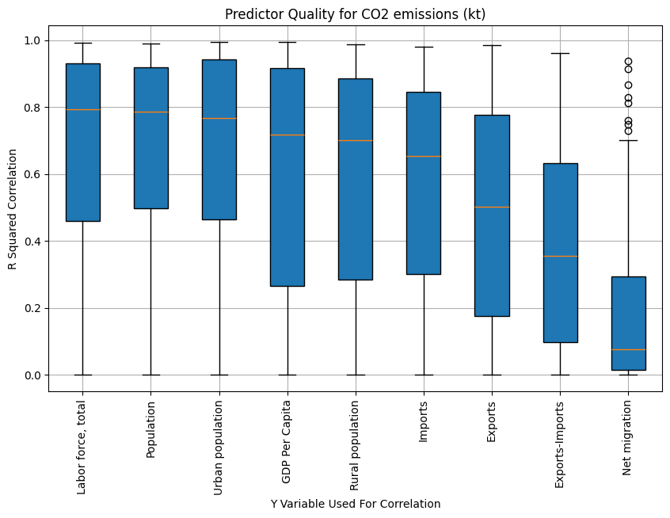
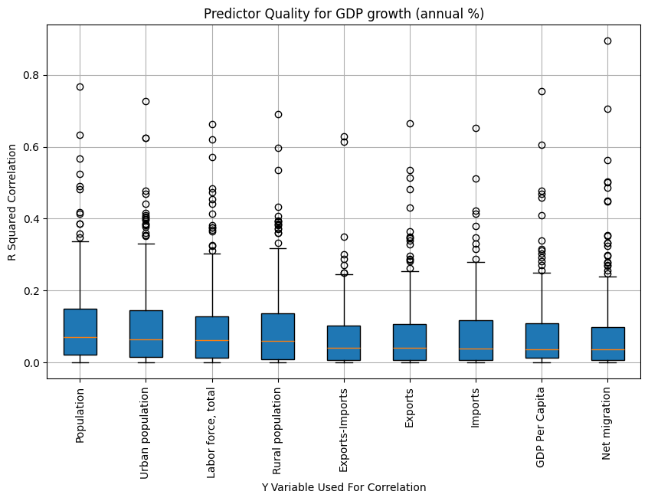
Economy-Based Economic Growth Results
Population based variables always most highly correlated
GDPPC always right behind them
Imports always slightly better than exports

Slide 12
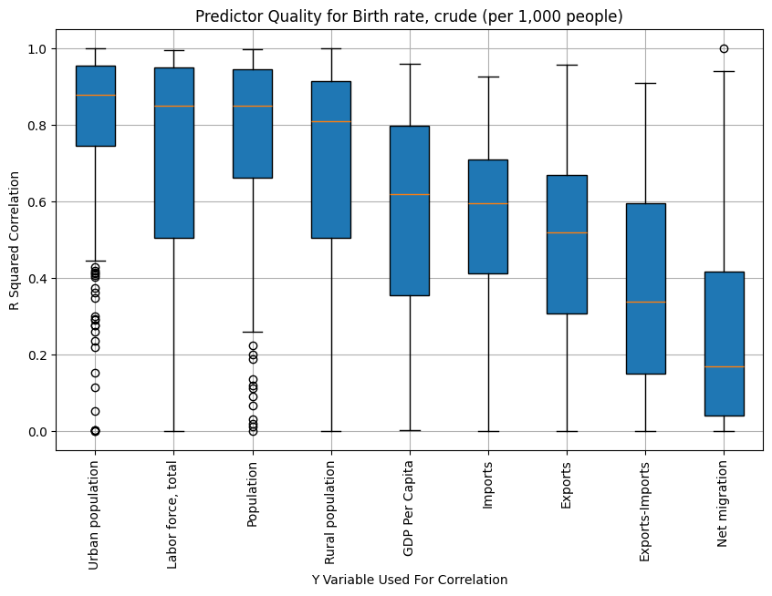
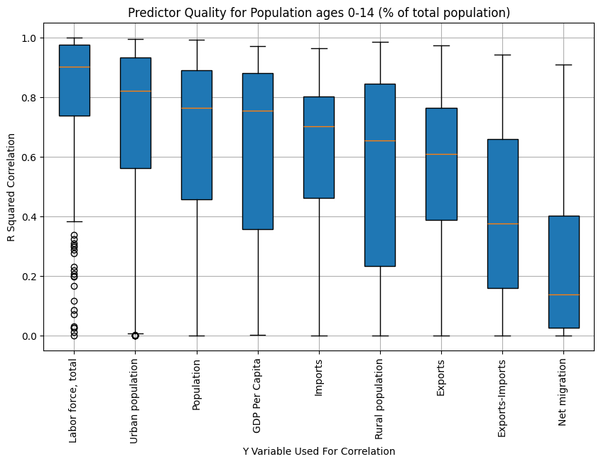
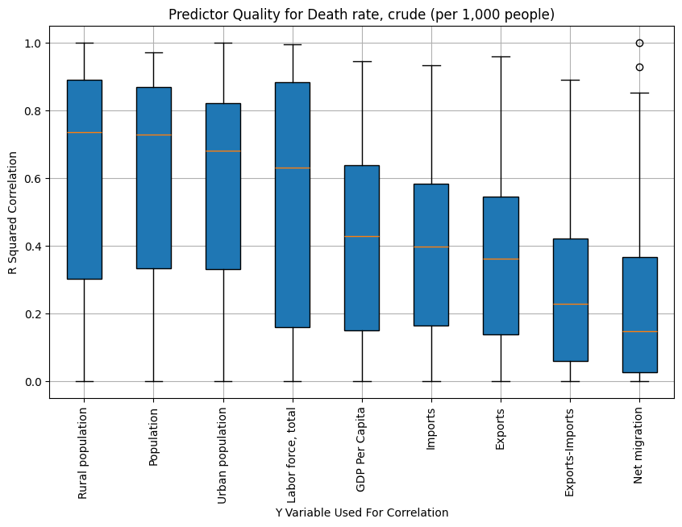
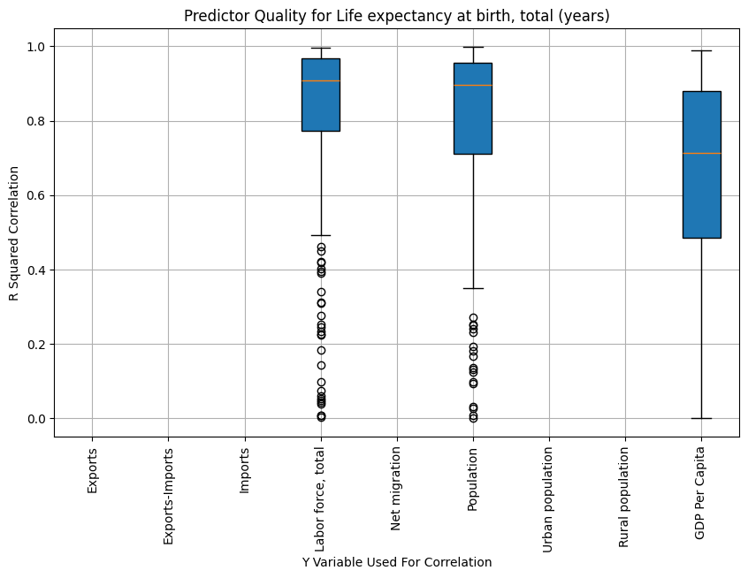
Health-Based Economic Growth Results
Ignore population based variables
Correlation direction matters, not decipherable on large scale
GDPPC always has highest median R² otherwise

Slide 13
Note of Caution
R² is correlation, not causation
These correlations are extremely high
Gives us confidence in our data
But also reminds us that there are many variables at play
This kind of analysis can help inform policy, but cannot explain the past

Slide 14
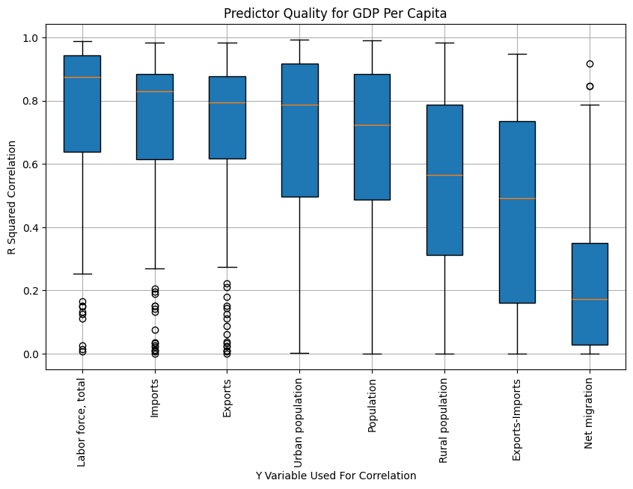
Coolest Finding: GDPPC Results
Labor force ≠ population
Even more highly correlated than importing and exporting is getting more people employed
Very often higher correlated

Slide 15
Constraints
Time available given amount of data
Data conventions and overlap
Correlation, no causation.
Year shift
Weights not given for greater populated countries
Correlated but without direction

Slide 16
Thank you

